Slide 1


ISO 8601: One Date/Time Format to Unite the World
Josh King
@WindosNZ king.geek.nz

Slide 2






Date Formats Around the World
9/12/2018
12/09/2018
2018-09-12
2018-09-12
12/09/2018
I… Um… Pass?
Flags of the world
Date format by country

Slide 3
2018-09-13T10:30:00
Year
Month
Day
Hour
Minutes
Seconds
ISO 8601 Anatomy

Slide 4
The Problem
Ambiguity
Americans writing code for Americans (no offense!)
Storing dates on disk
Transferring dates between systems

Slide 5
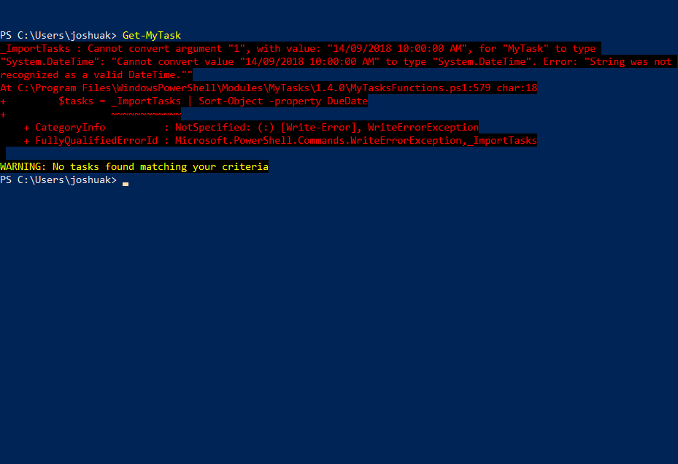
An Example in the Wild!
Jeff Hicks’ MyTasks Module
(This is fixed now)

Slide 6
But How?!
Gets written to disk
$newXML = $task |
Select-Object -Property Name, Description, DueDate, Category, Progress, TaskCreated, TaskModified, TaskID, Completed |
ConvertTo-Xml
Date
This outputs “14/09/2018 10:00:00 AM”
… Which can’t be converted back to a datetime object

Slide 7
But How?!
$newXML = $task |
Select-Object -Property Name,
Description,
@{Name = 'DueDate'; Expression = {Get-Date -Date $task.DueDate -Format 's'}},
Category,
Progress,
@{Name = 'TaskCreated'; Expression = {Get-Date -Date $task.TaskCreated -Format 's'}},
@{Name = 'TaskModified'; Expression = {Get-Date -Date $task.TaskModified -Format 's'}},
TaskID,
Completed |
ConvertTo-Xml
‘s’ for ‘Sortable’
This outputs “2018-09-14T10:00:00”
… Which can be converted back to a datetime object!

Slide 8
Hey! You Just Broke My DateTime!
PS C:\> $Date1 = Get-Date –Format ‘s’ PS C:\> $Date1.GetType()
STRING!!
PS C:\> $Date2 = Get-Date PS C:\> $Date2.GetType()
DateTime (Phew!)
PS C:\> $Date2.ToString(‘s’)
2018-09-14T10:48:55

Slide 9

Takeaways (And a Caveat)
If you’re writing dates to disk: ISO 8601
Passing dates between systems: ISO 8601
BUT! Use letters for months when dealing with humans: 14 Sep 2018
I happy to crash test your code!

Slide 10
THANK YOU!
Get this slide deck from:
http://bit.ly/Win8601
Get in touch:
@WindosNZ

